Slide 1
Introduction to Amazon Web Service

Slide 2
Session Objective
Cloud Computing
AWS – Introduction
AWS - Services

Slide 3
Cloud Computing

Slide 4
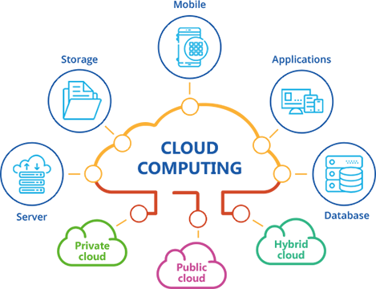
Cloud Computing
Cloud computing is an internet-based computing service in which large groups of remote servers are networked to allow centralized data storage, and online access to computer services or resources.
Using cloud computing, organizations can use shared computing and storage resources rather than building, operating, and improving infrastructure on their own.

Slide 5
Cloud Computing Features
Cloud computing is a model that enables the following features.
Users can provision and release resources on-demand.
Resources can be scaled up or down automatically, depending on the load.
Resources are accessible over a network with proper security.
Cloud service providers can enable a pay-as-you-go model, where customers are charged based on the type of resources and per usage.

Slide 6
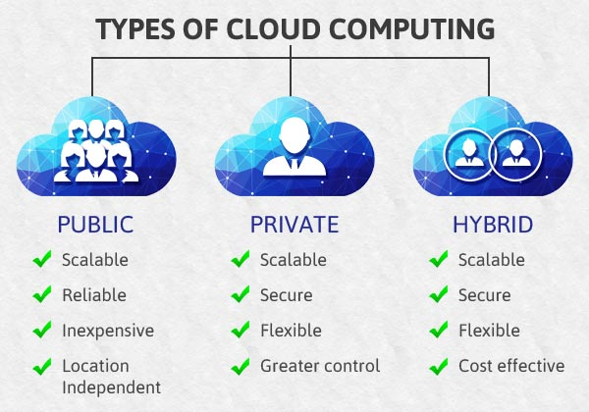
Types of Clouds -contd
There are three types of clouds –
Public cloud
Private cloud
Hybrid cloud

Slide 7
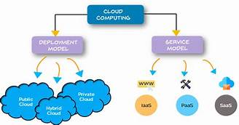
Types of Cloud

Slide 8
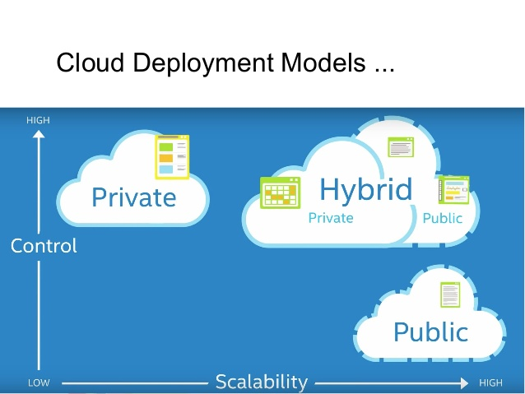
Deployment Model

Slide 9



Deployment Model

Slide 10
Deployment Model
Public
Private
Hybrid

Slide 11
Deployment Model -contd
Public Cloud
In public cloud, the third-party service providers make resources and services available to their customers via Internet. Customer’s data and related security is with the service providers’ owned infrastructure.
Private Cloud
A private cloud also provides almost similar features as public cloud, but the data and services are managed by the organization or by the third party only for the customer’s organization. In this type of cloud, major control is over the infrastructure so security related issues are minimized.

Slide 12
Deployment Model
Hybrid Cloud
A hybrid cloud is the combination of both private and public cloud. The decision to run on private or public cloud usually depends on various parameters like sensitivity of data and applications, industry certifications and required standards, regulations, etc.

Slide 13
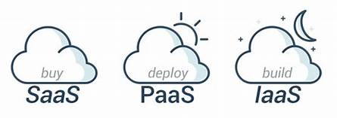
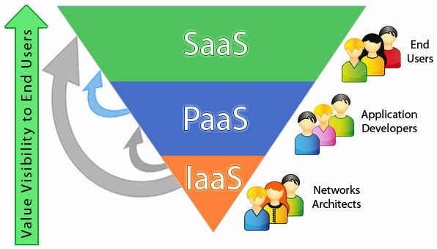
Service Model

Slide 14



Service Model

Slide 15
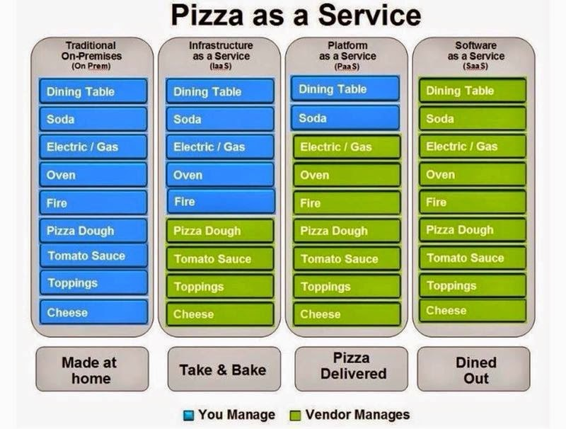
Service Model

Slide 16
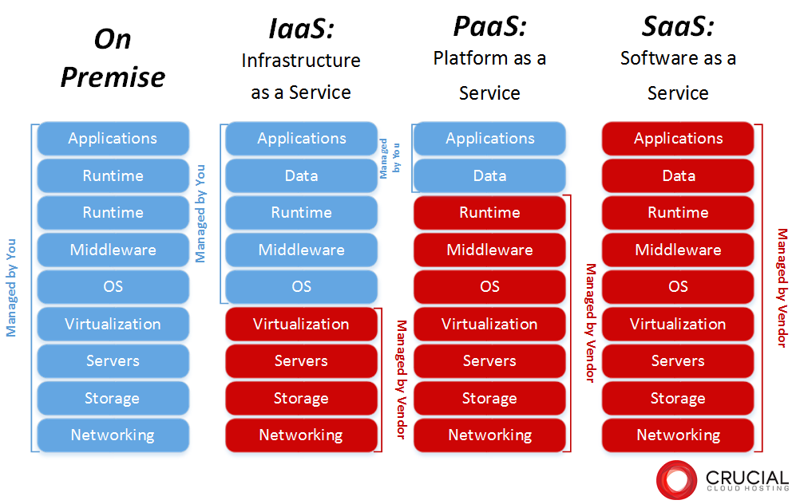
Service Model

Slide 17
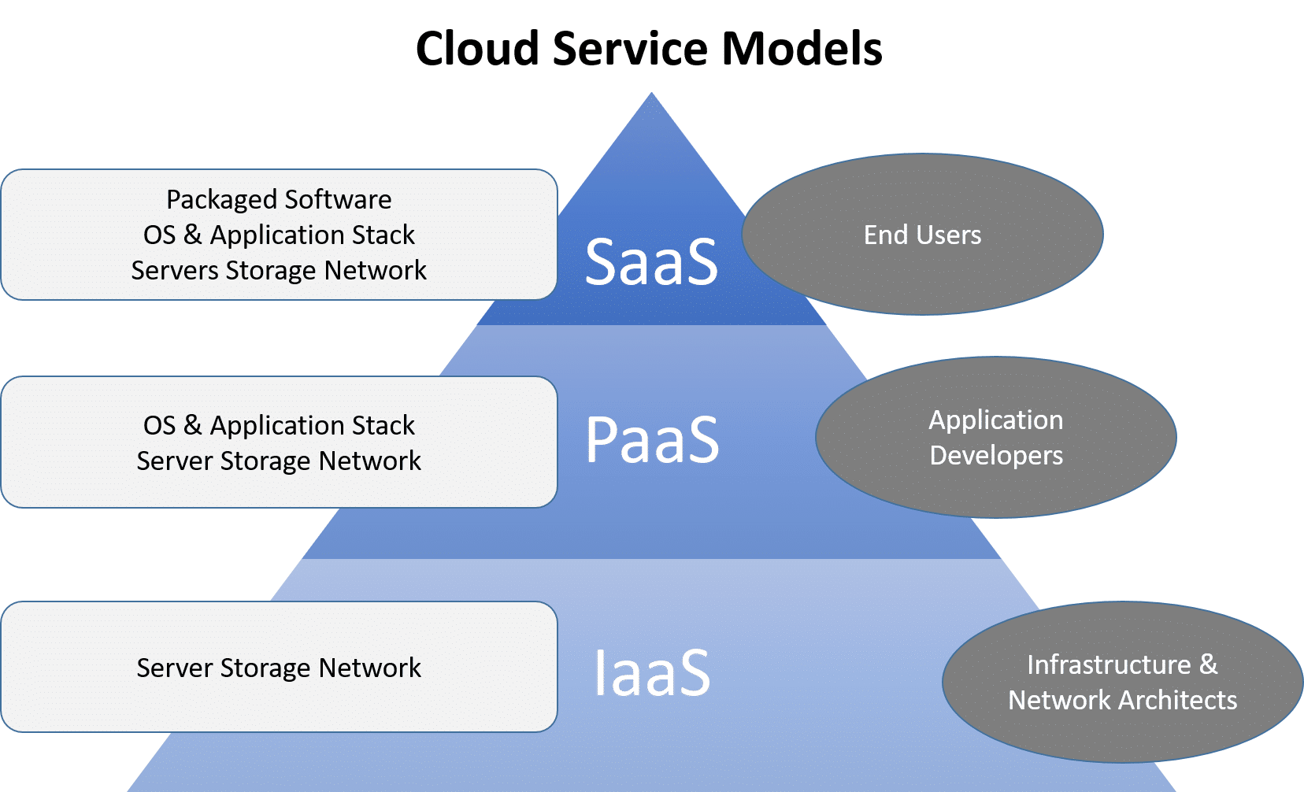
Cloud Service Models
There are three types of service models in cloud
IaaS - Infrastructure as a Service
PaaS - Platform as a Service
SaaS - Software as a Service

Slide 18
Advantages of Cloud Computing -contd
Cost-Efficient
Building our own servers and tools is time-consuming as well as expensive as we need to order, pay for, install, and configure expensive hardware, long before we need it.
Using cloud computing, we only pay for the amount we use and when we use the computing resources. In this manner, cloud computing is cost efficient.
Reliability
A cloud computing platform provides much more managed, reliable and consistent service than an in-house IT infrastructure.
It guarantees 24x7 and 365 days of service. If any of the server fails, then hosted applications and services can easily be transited to any of the available servers.

Slide 19
Advantages of Cloud Computing -contd
Backup & Recovery
Storing data in the cloud, backing it up and restoring the same is relatively easier than storing it on a physical device.
The cloud service providers also have enough technology to recover our data, so there is the convenience of recovering our data anytime.
Easy Access to Information
Once you register yourself in cloud, you can access your account from anywhere in the world provided there is internet connection at that point.
There are various storage and security facilities that vary with the account type chosen.

Slide 20
Advantages of Cloud Computing
Unlimited Storage
Cloud computing provides almost unlimited storage capacity, i.e., we need not worry about running out of storage space or increasing our current storage space availability. We can access as much or as little as we need.

Slide 21
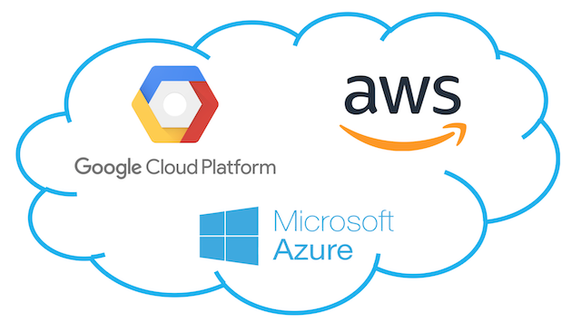
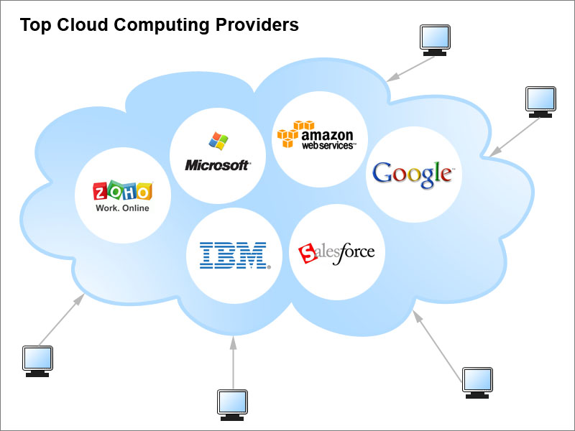
Cloud Providers
https://www.youtube.com/watch?v=QJncFirhjPg

Slide 22
Amazon Web Service

Slide 23
What is AWS?
Amazon Web Services(AWS) is a cloud service from Amazon, which provides services in the form of building blocks, these building blocks can be used to create and deploy any type of application in the cloud.
These services or building blocks are designed to work with each other, and result in applications which are sophisticated and highly scalable.

Slide 24
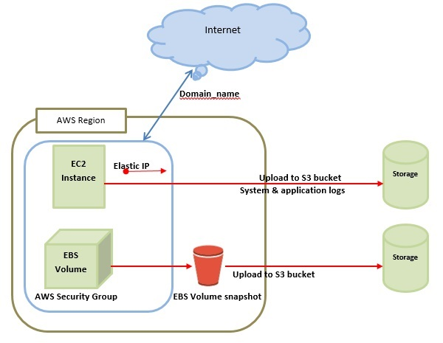
AWS ─ Basic Architecture

Slide 25
AWS Introduction
Cloud computing is the on-demand delivery of compute power, database storage, applications, and other IT resources through a cloud services platform.
Cloud computing provides a simple way to access servers, storage, databases and a broad set of application services over the Internet.
A cloud services platform such as Amazon Web Services owns and maintains the network-connected hardware required for these application services.

Slide 26
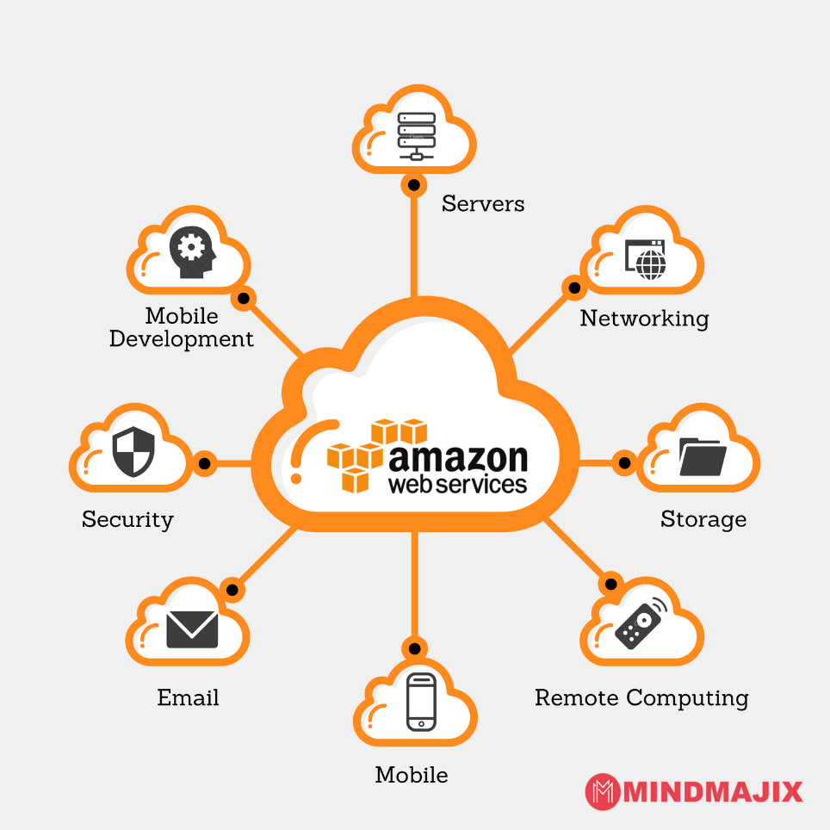
Amazon Web Service
Amazon Web Services (AWS) is a secure cloud services platform, offering compute power, database storage, content delivery and other functionality to help businesses scale and grow.

Slide 27
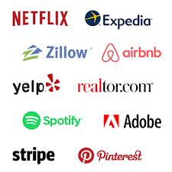
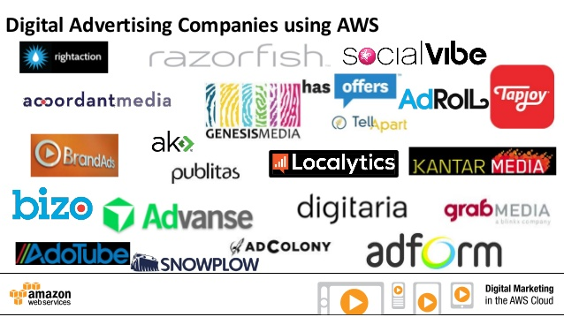
Companies using AWS

Slide 28
AWS – Example -contd
Back in 2006-2007, companies were using their own private servers to create services like for storage, computing, etc. But now with internet speeds becoming better, companies big or small have started understanding the power of the cloud, therefore they are shifting their data to the cloud for improved performance, so that they can focus on core-competency.

Slide 29
AWS – Example -contd
Back in 2006-2007, companies were using their own private servers to create services like for storage, computing, etc. But now with internet speeds becoming better, companies big or small have started understanding the power of the cloud, therefore they are shifting their data to the cloud for improved performance, so that they can focus on core-competency.

Slide 30
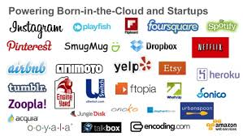
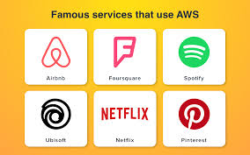
AWS – Example -contd

Slide 31
AWS – Example -contd

Slide 32




AWS – Example -contd

Slide 33
AWS – Example -contd
Pinterest:
Pinterest, Inc. is a social media web and mobile application company that operates a software system designed to discover information on the World Wide Web, mainly using images and, on a smaller scale, GIFs and videos
Spotify
Spotify is a Swedish audio streaming platform that provides DRM-protected music and podcasts from record labels and media companies
Netflix
The company's primary business is its subscription-based streaming OTT [Over the top (OTT) is a term used to refer to content providers that distribute streaming media ]service which offers online streaming of a library of films and television programs, including those produced in-house
Expedia
Expedia.com is a travel booking website owned by Expedia Group. The website can be used to book airline tickets, hotel reservations, car rentals, cruises and vacation packages.

Slide 34
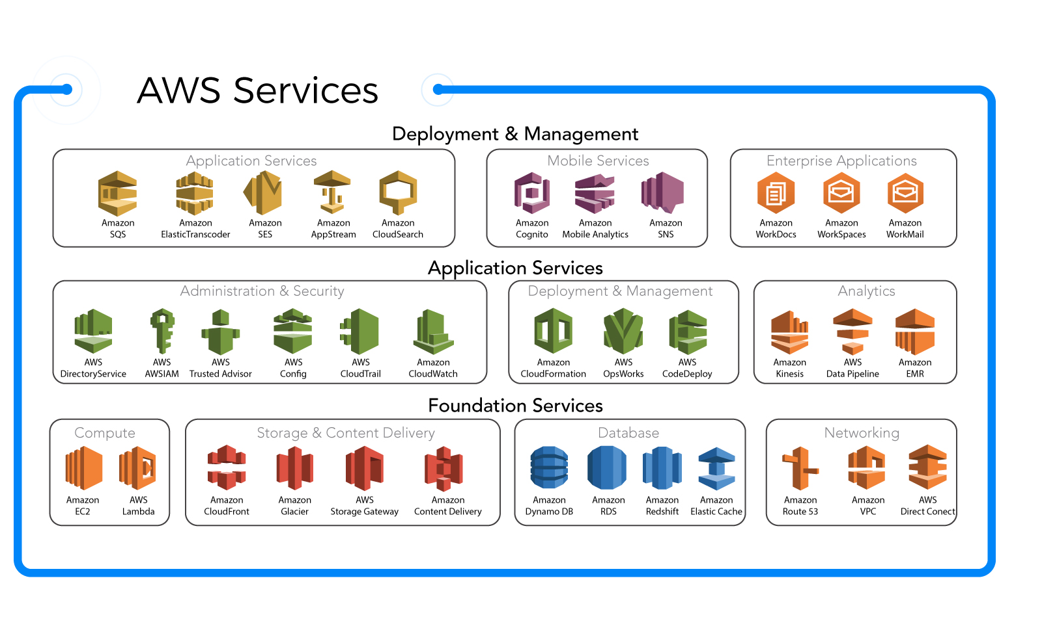
AWS Services

Slide 35
AWS product categories
AWS offers a wide range of services that can be categorized in following categories –
Compute and Networking Services
Storage and Content Delivery Services
Security and Identity Services
Database Services
Analytics Services
Application Services
Management Tools

Slide 36
AWS – Compute Service
The Compute domain includes services related to compute workloads, it includes the following services:
EC2 (Elastic Compute Cloud)
Lambda
Elastic Beanstalk
Amazon LightSail

Slide 37
AWS – Storage Service
The Storage domain includes services related data storage, it includes the following services:
S3 (Simple Storage Service)
Elastic Block Store
Amazon Glacier
AWS Snowball

Slide 38
AWS – Database Service
The Database domain is used for database related workloads, it includes the following services:
Amazon Aurora
Amazon RDS
Amazon DynamoDB
Amazon RedShift

Slide 39
AWS – Migration Service
The Migration domain is used for transferring data to or from the AWS Infrastructure, it includes the following services:
AWS database Migration Service
AWS SnowBall

Slide 40
AWS – Networking & Content Delivery Service
The Networking and Content Delivery domain is used for isolating your network infrastructure, and content delivery is used for faster delivery of content. It includes the following services:
Amazon Route 53
AWS CloudFront

Slide 41
AWS – Management Tools
The Management Tools domain consists of services which are used to manage other services in AWS, it includes the following services:
AWS CloudWatch
AWS CloudFomation
AWS CloudTrail

Slide 42
AWS - Security & Identity, Compliance
The Security & Identity, Compliance domain consist of services which are used to manage to authenticate and provide security to your AWS resources. It consists of the following services:
AWS IAM
AWS KMS
AWS Shield

Slide 43
AWS – Messaging Service
The Messaging domain consists of services which are used for queuing, notifying or emailing messages. It consists of the following domains:
Amazon SQS
Amazon SNS
Amazon SES
Amazon Pinpoint

Slide 44
Advantages of AWS -contd
Flexibility
AWS provides effortless hosting of legacy applications. AWS does not require learning new technologies and migration of applications to the AWS provides the advanced computing and efficient storage.
Cost-effectiveness
AWS requires no upfront investment, long-term commitment, and minimum expense when compared to traditional IT infrastructure that requires a huge investment.

Slide 45
Advantages of AWS
Scalability/Elasticity
Through AWS, autoscaling and elastic load balancing techniques are automatically scaled up or down, when demand increases or decreases respectively. AWS techniques are ideal for handling unpredictable or very high loads. Due to this reason, organizations enjoy the benefits of reduced cost and increased user satisfaction.
Security
AWS provides end-to-end security and privacy to customers.
AWS has a virtual infrastructure that offers optimum availability while managing full privacy and isolation of their operations.
Customers can expect high-level of physical security because of Amazon's several years of experience in designing, developing and maintaining large-scale IT operation centers.

Slide 46
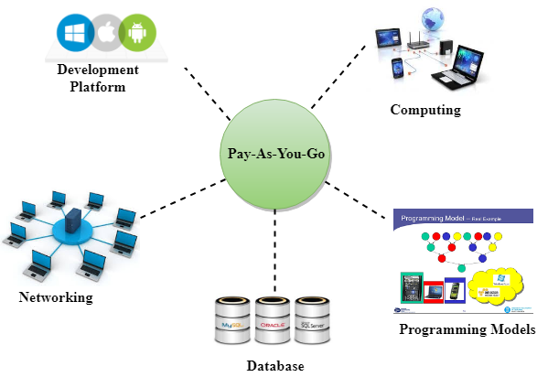
Pay-As-You-Go
AWS provides services to customers when required without any prior commitment or upfront investment. Pay-As-You-Go enables the customers to procure services from AWS.
Computing
Programming models
Database storage
Networking

